Slide 1
Bridging the Gap:
Enhancing Communication and Cultural Competence in Older Adults
Kathy Kirby- RN
Directors

Slide 2
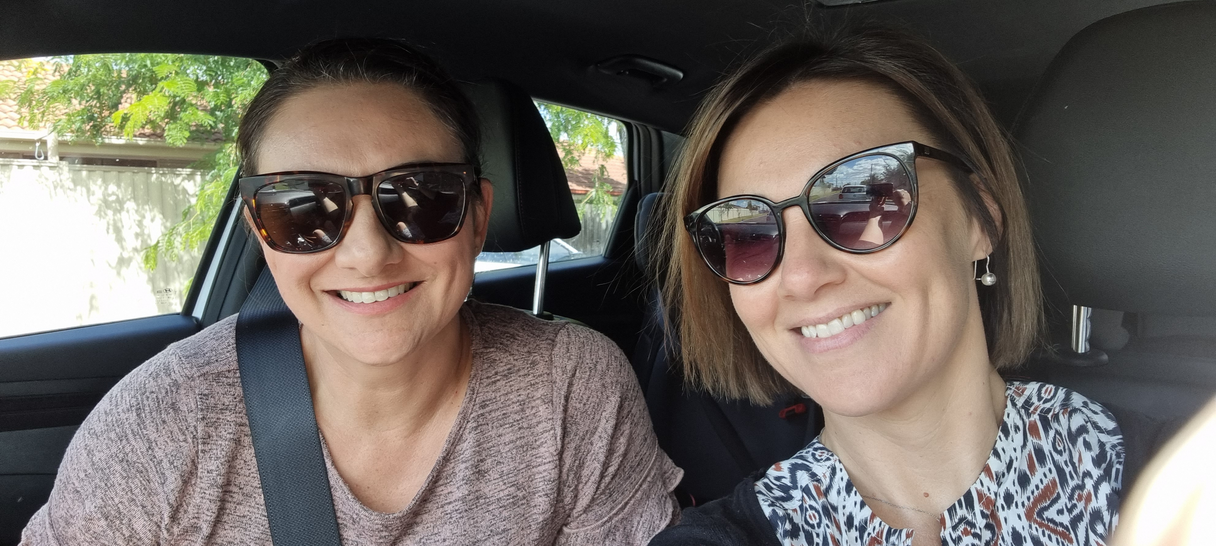
Introductions

Slide 3
About today
What are we going to cover:
What is communication
How do we communicate
Why we have challenges with communication
Adapting our communication depending on the situation
Cultural factors
Coping with challenges
Notes:
Today we are going to focus on verbal communication.

Slide 4
Scenario
‘Hi Betty,
Good morning! How did you sleep? It is a nice day today. Are you ready for breakfast or would you like a shower first? How are your knees feeling- they were sore yesterday, are they ok or are they still sore?’
What was the purpose of this interaction?
Notes:
Kathy- Let’s start with a common scenario and pop into the chat if this sounds like a somewhat familiar conversation? I want you to consider yourself as being ‘Betty’ and see how you feel. Read out the scenario
What was the purpose of my interaction with Betty? What was I trying to achieve? (WHAT WAS MY AGENDA?) Assessment, introduction, care delivery- medication, breakfast, hygiene, pain management. Trying to find out information

Slide 5
Definition
‘The exchange of information, ideas, or knowledge through speech, writing, or mechanical or electronic media.’
What were the key things you noticed when I was communicating to Betty?
Notes:
The oxford dictionary definition is: ….
And that is what we were trying to achieve with Betty wasn’t it. I wanted to share information with her, and I wanted her to share information back to me. Great! Communication is happening. But …. How do you think it went with Betty?
What do you notice about what was communicated by me? What did you notice about HOW I communicated? How did I approach Betty? How did you feel when I spoke? Reflect from the chat
Next slide has what was noticed.
What do you notice about what was communicated by me? What did you notice about HOW I communicated? How did I approach Betty? How did you feel when I spoke? Reflect from the chat

Slide 6
What did we notice about this communication?
Lots of words
Lots of ‘options’ given
Cheery tone
Facial expression
No time to ‘think’
How do you think ‘Betty’ felt during the interaction?
How do you think I was feeling during the interaction?
WHY is that important?
Notes:
I used lot’s of verbal information, lots of talking, lots options- breakfast or shower and a lot of information going in and out.
So how do you think I was feeling when I was talking to Betty- what mood do you think I was in? WHY do you think that? (body language, smiling etc) Maybe you felt a bit overwhelmed with my words or pace?
Why is that important? Let’s talk some more about what can impact on communication.
What kind of an experience was this? Would you say it was positive or negative?
Our mood, affects how we communicate.
Stress has a big impact on our brain and how we respond. We can be in a state of stress in our day to day lives, but a person LWD can also experience stress on top of the brain change that is occurring due to their disease.
So let’s try the scenario again, but this time in a different state.

Slide 7
Scenario Take 2
‘Hi Betty,
Good morning! How did you sleep? It is a nice day today. Are you ready for breakfast or would you like a shower first? How are your knees feeling- they were sore yesterday, are they ok or are they still sore?’
In what way was this different to the first interaction?
How might this impact on the outcome we were trying to achieve?
Notes:
Grab note pad, look at watch, flat tone, look busy and disinterested.
Use the Chat option- …
So, let’s look at what was so different about both interactions.

Slide 8
What changed the interaction
Tone of voice
Pitch
Pace- how fast I was talking
My facial expressions
My body language- how and where I was standing, where am I looking
Same words, Different experience. WHY?
Notes:
How were these experiences different? Well let’s consider both scenarios.
1- smiling, friendly, looking at Betty, fast pace,
2-not smiling, distracted- looking at watch and papers, appears disinterested, flat tone and pitch, medium pace. Flat affect.

Slide 9
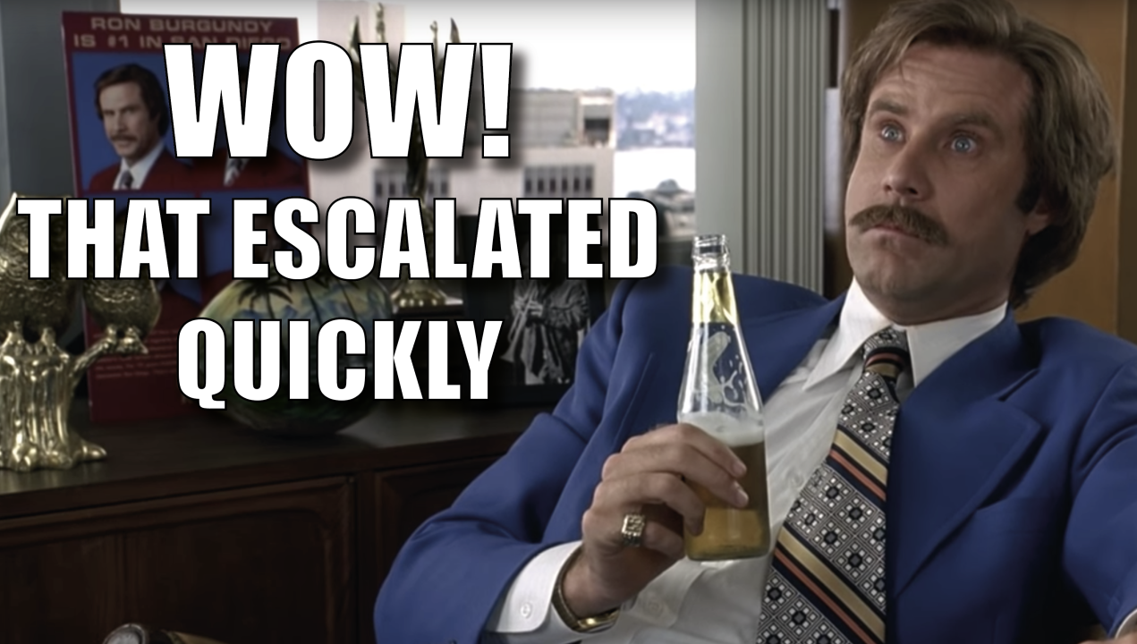
POP QUIZ: Body language
Answer these questions:
Write down the percentage for each of these components of how humans communicate:
Words
Non-verbal: body movements
Vocal: voice and tone
7% -Words
55%- Non-verbal: body movements
38% -Vocal: voice and tone
Notes:
Which one do you think is the highest percentage?
The 55/38/7 FormulaIt was Albert Mehrabian, a researcher of body language, who first broke down the components of a face-to-face conversation. He found that communication is 55% nonverbal, 38% vocal, and 7% words only.
So, thinking about this and working with older people and people from different cultural backgrounds, what might some of the challenges be with relying on our ‘words’ alone to convey a message?

Slide 10
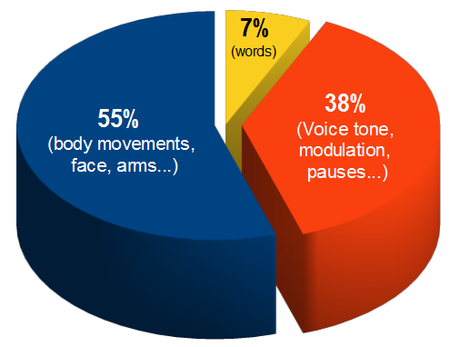
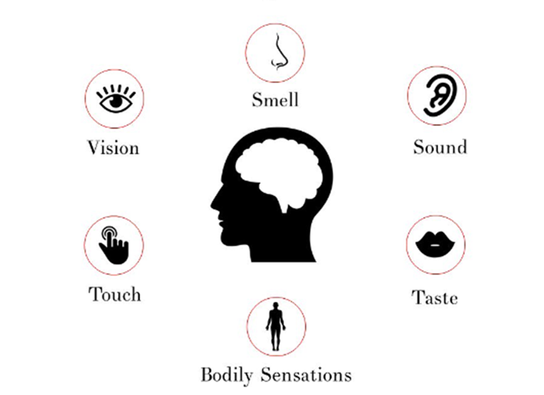
Why our approach matters
Notes:
How many of us in the room have English as a second language?
How many of us are communicating with residents who have English as a second language?
How many of us or our residents come from different cultural backgrounds?
So, relying on words isn’t going to be effective is it? Because, words can also have different interpretations to different people
This is why thinking about the other 93% of communication is important.
And often times, we use our body and visual cues without thinking about it.
What we also do without realizing is change our tone. EG: asking a question louder when you don’t get a response. Now, that might address one issue if hearing is impacted for the older person, but what if that isn’t the case? What else can we do… we can use more visual prompts.
Something else that we need to consider, is when a person is experiencing brain change. So, stress or let’s say dementia.
We have a picture of our senses to the right, we know them. Our senses take in the information from our environment and our brain processes this information to make sense of it so we can respond to it in a way that makes sense. WE know that often times, these senses change as we age.
For people with dementia their brains are going through change – This will affect their ability to take in information and how they process this information and we will touch more on that a bit later.

Slide 11
What can poor communication lead to?
Negative impact on relationships with residents, family members as well as team members including:
Misunderstandings
Dissatisfaction
Unnecessary conflict
Reduced productivity
Poor teamwork
Low morale
Notes:
And what does that usually lead too… complaints
Misunderstandings
Low morale
Poor communication can make it difficult for employees to meet expectations and deadlines, which can lead to low morale.
Reduced productivity
Poor communication can reduce productivity because employees spend more time correcting mistakes and clarifying information.
Client dissatisfaction
Poor communication can lead to unmet expectations and client dissatisfaction.
Poor teamwork
Poor communication can make it difficult for staff members to collaborate, which can lead to poor teamwork and friction among employees.
Unnecessary conflict
Poor communication can lead to unnecessary conflict, which can increase stress levels and impact mental and physical health.
This leads me into the next slide which is some facts about complaints.

Slide 12
The facts
In the 2021/22 year, HDC received 183 complaints relating to aged residential-care (ARC) facilities.
Common complaint themes for this period were:
ineffective communication with consumers and their whānau
Let’s talk about how we can do things differently
Notes:
Health and disability commissioner reported….. Amongst others but this was at the top of the list. So, let’s talk about how we can do things differently.

Slide 13
Tell me your story
What are some of the challenges you currently face with communication?
Notes:
Write some comments in the chat. While you are doing that, let’s talk about impacts for older people

Slide 14
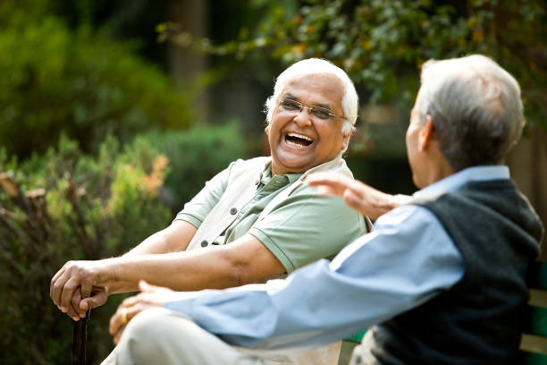
Impacts on communication with older people
Common changes:
Hearing changes/loss
Vision changes/loss
Physical limitations
Mood and motivation
Brain changes
How might these have an impact on an older person each day?
Notes:
Potentially as an older person, we may not hear the question or what we are saying- culture and our own voice can play a part in this as well as some people may have a soft tone, others may naturally speak louder.
Vision- changes may mean that visual prompts are a challenge
Brain changes- ability to understand language, vocabulary, decision making
Physical limitations- ability to write, changes to independence- frustration
Mood and motivation- anger, depression, embarrassment
Brain changes- talk about that now

Slide 15
What does brain change look like
In order to help understand the changes that occur with dementia, we want to show you images of two brains
Notes:
Before we get started we are going to show you real images of the brain over the next two slides to get you thinking about the changes affecting a person living with dementia
Why are we focusing on this? Because in NZ, Almost 70,000 Kiwis are living with dementia mate wareware today.
Almost 170,000 Kiwis are likely to be living with dementia mate wareware by 2050
Dementia mate wareware numbers are increasing at a faster rate among Māori, Pacific peoples and Asian populations than those of European New Zealanders.

Slide 16
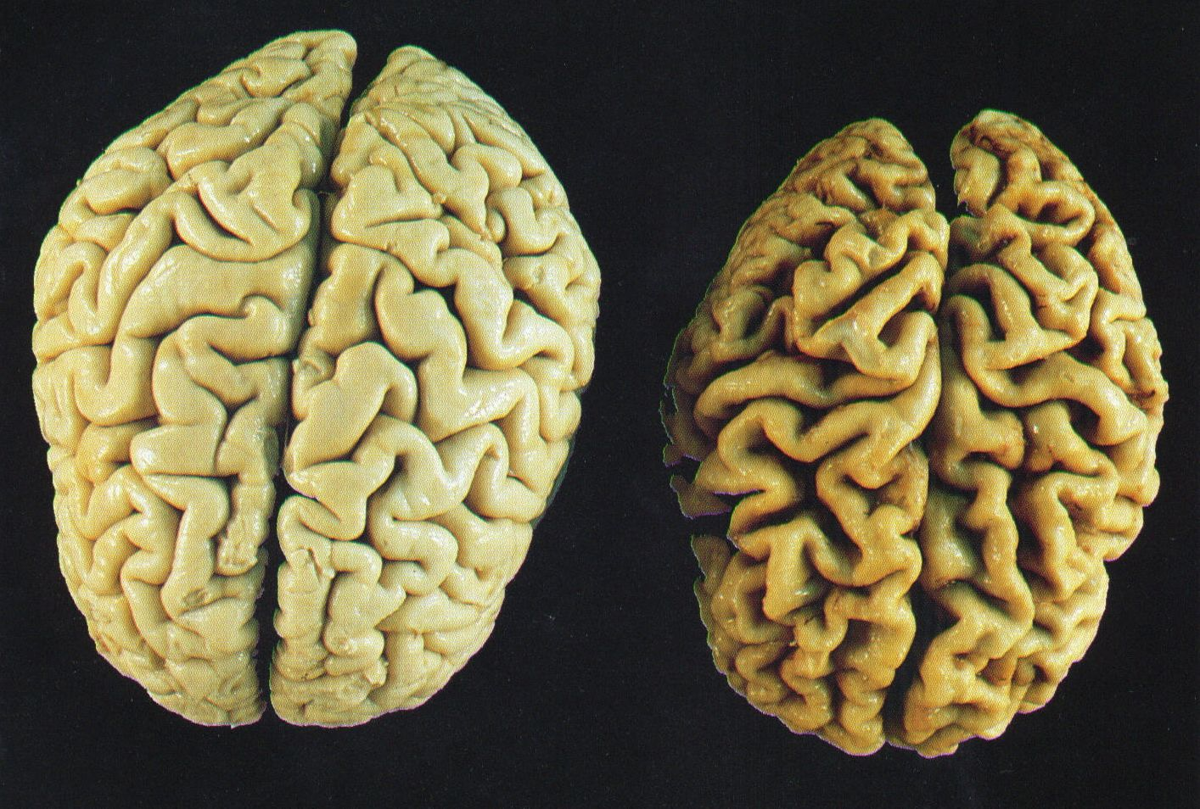
*Used with permission from A Broken Brain
Notes:
Let’s have a look at the brain – We know that the brain is made of two part (L and R)
Go ahead and make two fists - put them together – our left and right side – our left and right hemispheres
The brain is complex – the right side controls our movement on our left and our left side of the brain controls our movement on the right
Here we can see the brains from 2 men, roughly the same age, height, and head circumference at death. The brain on the left is from a man that died from an accident with a healthy brain. The brain on the right is from a man that died from complications of living with Alzheimers disease for over 10 years.
“What do you notice about the two brains?
So now we are going to talk about changes that occur to our language centre

Slide 17
Understanding Language
Hearing sound is not affected by dementia but the part of the brain responsible for understanding language is
Notes:
Kate

Slide 18
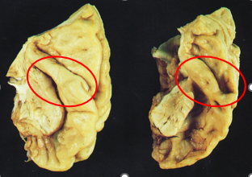
Hearing Sound – Not Changed
*Used with permission from A Broken Brain
Notes:
-Okay – Moving on:
Early in this (disease) people will miss (1) out of 4 (words). How long before (you) got Lost do (you) think?
Say once –
Say again
Say louder, angrier / frustrated….
Then say the whole sentence – softer, questioning
It makes it hard to understand things when you miss every 4th word.
How did you feel when I got louder? When my tone got angier?
Hearing doesn’t change with dementia ( although a person can have age related changes) - People with dementia can still hear Tone, pitch, volume, intensity
What changes is their ability to understand language - the person living with dementia

Slide 19
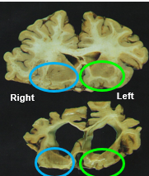
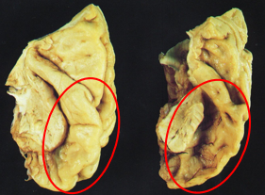
Understanding Language – Big Changes
*Used with permission from A Broken Brain
Notes:
What does change is a person's ability to understand language -
These images here are of the temporal lobe
The temporal lobe is the area of the brain that helps you understand the world around you and respond to it
The image in the left is the Left temporal lobe – what do you notice about the second brain affected by dementia
The image on the right is the R and L temporal lobe – Which do you notice to be most affected by dementia?

Slide 20
Language Changes
Left temporal lobe- Loss
Vocabulary
Comprehension
Speech production
Right temporal lobe- Retained
Forbidden words
Social chit - chat or turn taking
Production and understanding rhythm of speech – frequency, intensity, volume
Music, poetry, prayer, and counting
Automatic, autonomic movements, the things you do without thinking
Notes:
Let’s talk about what each temporal lobe is responsible for and how it is affected by dementia:
It is important to be aware of the affects of brain change on our language. If we have a better understanding, then it can help us understand WHY we may experience communication challenges. Understanding that it is physical changes can help make sense of WHY we may experience the ‘verbal abuse’ swearing, inappropriate comments.
Get your three on your left hand ready (show your thumb, first finger, and middle finger as skill fingers and tap your left temple).
Your LEFT temporal lobe is in charge of 3 things. Vocabulary (thumb), comprehension (first finger towards you), and speech production (middle finger away from you). These our SKILLS - Vocab, comprehension and speech production.
On the right temporal lobe we have our strengths – Show right hand – 5 fingers wriggling. And we retain these.
forbidden words ( swear words, sex talk, racial slurs, ugly words (fatso, ugly etc) (thumb),
social chit- chat or turn taking (first finger pointing back and forth from you to them) – hello / how are you? Im good – how are you
production and understanding rhythm of speech – frequency, intensity, volume, and asking questions (use middle finger to go with what you are saying),
music, poetry, prayer, and counting (use all four fingers to go with what you are saying),
and finally automatic, autonomic movements, the things you do without thinking (use your hand still by your face and offer a handshake to someone).”
Dementia robs us of our skills – Left 3 fingers ( our vocab / comprehension and speech production) , but we keep our strengths – right 5 fingers – the forbidden words, the social chit chat, rhythm of speech, music poetry and counting and our automatic and autonomic movements

Slide 21
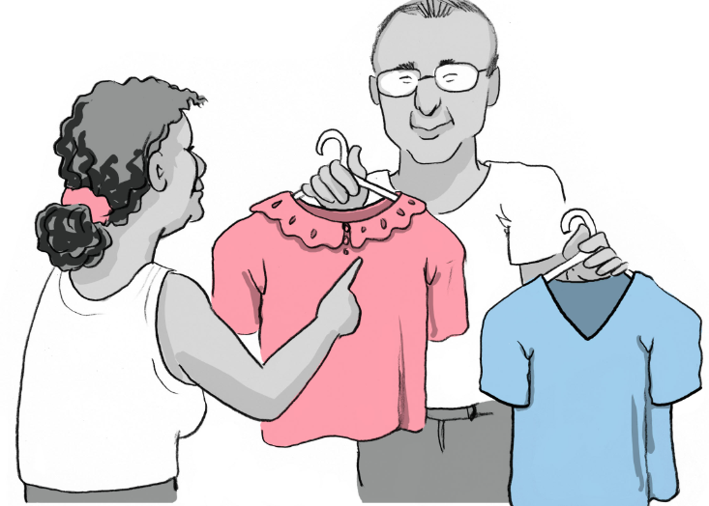
Language - Top Tips
Allow time to respond (3-5 secs)
Use less words
Use more visual cues
Watch your tone – the person may not understand your words but will understand your tone
‘Language on the left, rhythm on the right.
We LOSE on the left and RETAIN on the right
Notes:
So thinking about these language changes - How can we consider our communication
Here are some tips we can use to better meet the needs of the person we are supporting with dementia
Response time- Wait a bit longer – 3-5 seconds – this allows time for the message to be received and processed and the person to generate a response
Use less words – remember a person with mid stage dementia will miss every 1 in 4 words – so use less – simple short sentences. It can also help ourselves if we are not overly confident with English as a first language for either us or our residents. Less words more visual prompts can help to reduce stress and miscommunication
Add more visual cues – even though visual field is changing, vision remains a strength and will assist with verbal comprehension – show what your talking about –
Watch you tone – tone is a strength is retained – I may not understand what your asking me but I can pick up on your tone, if your happy, or angry- and I will respond to this tone
I want to now just quickly touch on our visual processing centre as well and I will talk about WHY this is also important.

Slide 22
Our visual processing centre
Vision Center – Big Changes
*Used with permission from A Broken Brain
Notes:
Vision is the main sense we rely on to stay safe and for PLWD it is the main way they take in information
The areas circled are the back of the brain – the occipital lobe – the visual processing centre.
What is different in the 2 circles? -(Colour / Size / Structure)
Why does vision processing change with dementia in this picture? (Damage to wiring and skills of brain. Eyes take info in – to bac to process it.)
What changes in skills or ability will likely happen for someone living with brain change? ( does not show other vision changes – just progression with dementia glaucoma / mac degeneration etc)
Given these changes may be happening to someone with dementia what is one visual cue you could add to your standard greeting?
If we consider that our visual field gets smaller as we age and if we have dementia (binocular vision), let’s consider how that may impact on our face to face communication. We spoke about body movements earlier and how this accounts for 55% of our this interaction, so imagine you can only see what is within your binocular vision, plus you have some hearing and vision impairment. Now add in our scenario’s from earlier and we could potentially see a few things occur.

Slide 23
Escalation
How did we get from Image A to Image B?
Notes:
Potentially, we can see an escalation of what we label ‘behaviours.’ WHY has this occurred? Because of our approach. Not that we intended it to happen but when you have multiple factors such as:
-hearing loss
-vision changes
-brain change
-English as a second language
-Cultural differences we can sometimes encounter some challenges. So what else can we do to minimize this from occurring.

Slide 24
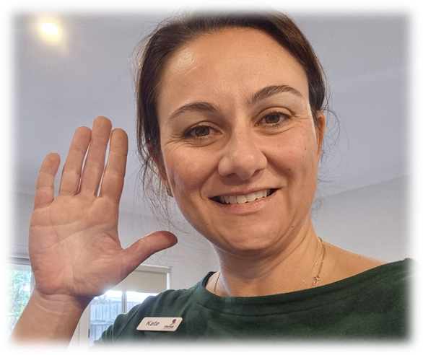
Vision – Top Tips
Approach from the front - move slowly, don’t rush in
Get the person’s attention - wait for eye contact
Get on the person’s dominant side
Get on the same level – don’t stand over someone
Facial Expression and Body Language – Keep it positive – PLWD recognize these cues
Notes:
When were thinking how we can better support our people with dementia, acknowledging the changes happening with their visual field and changing our approach to better suit their needs here are some tips that may help:

Slide 25
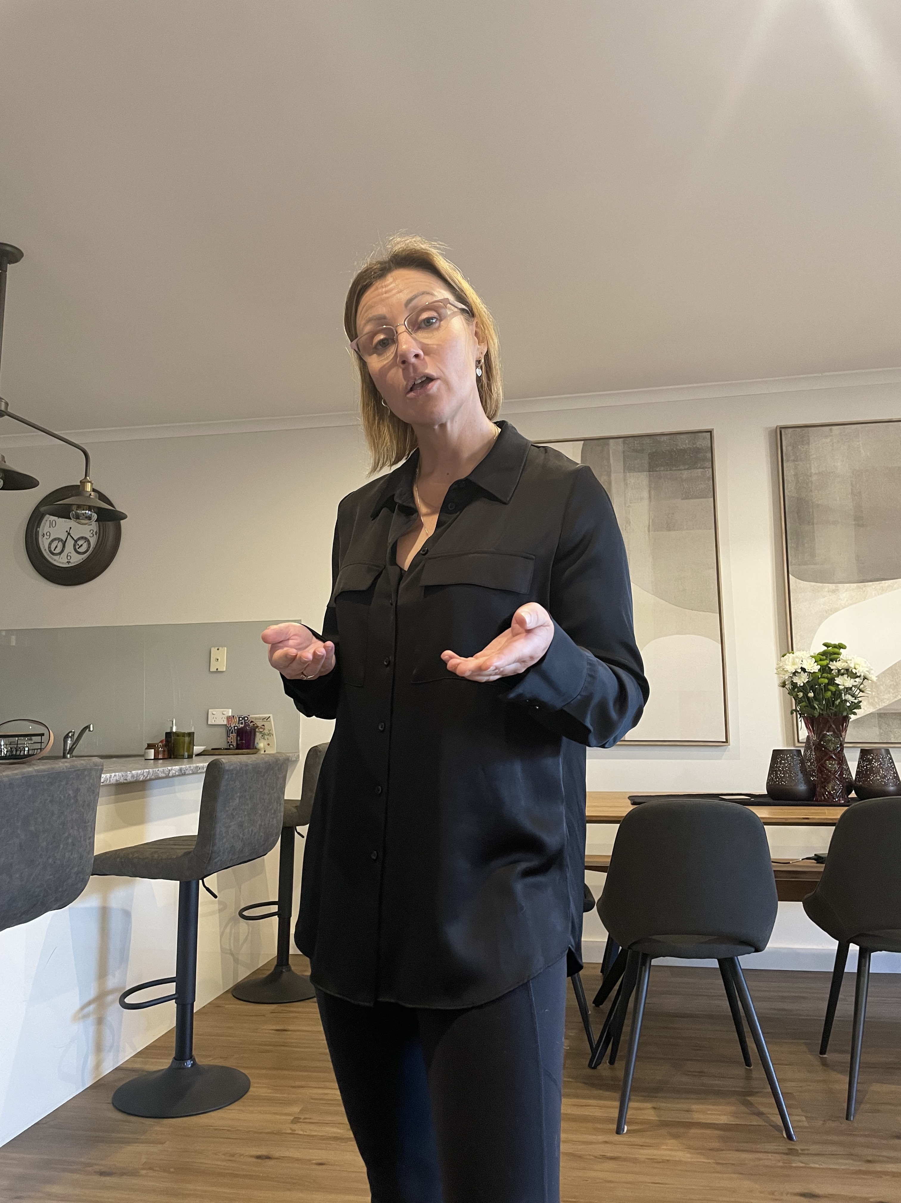
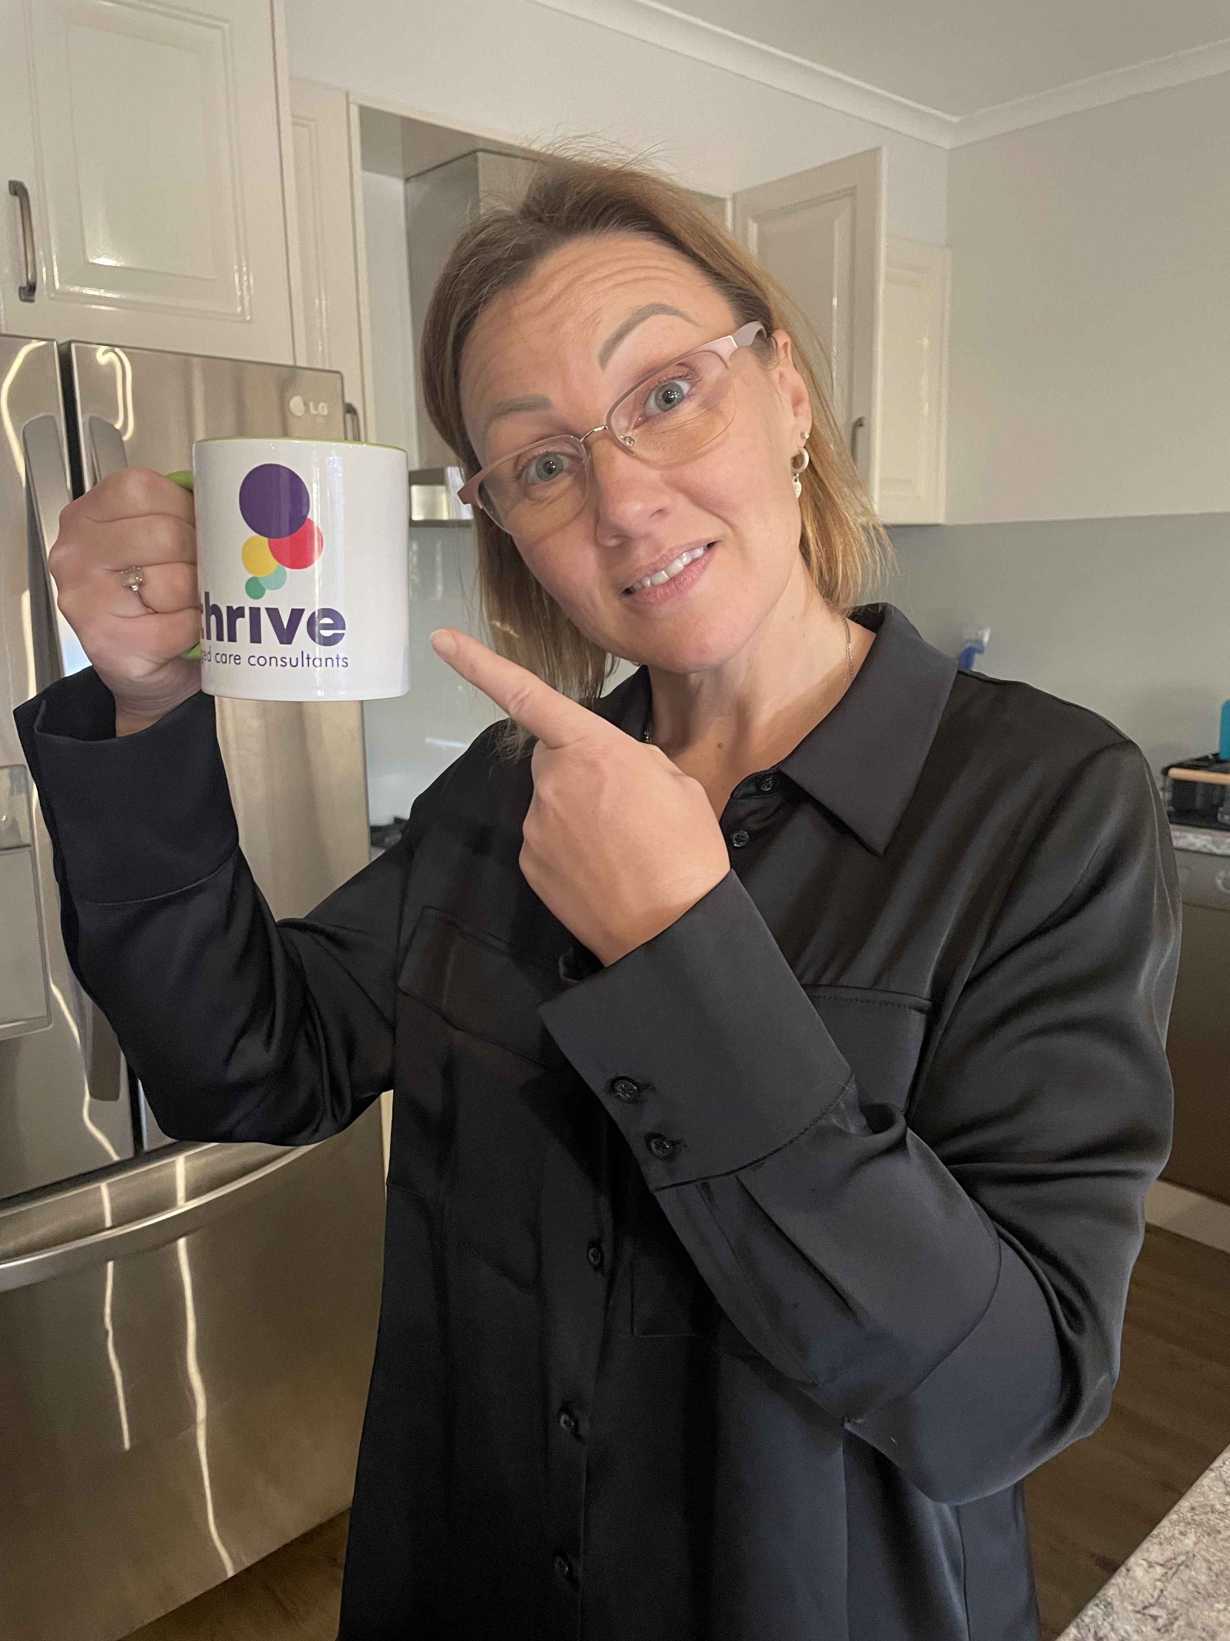
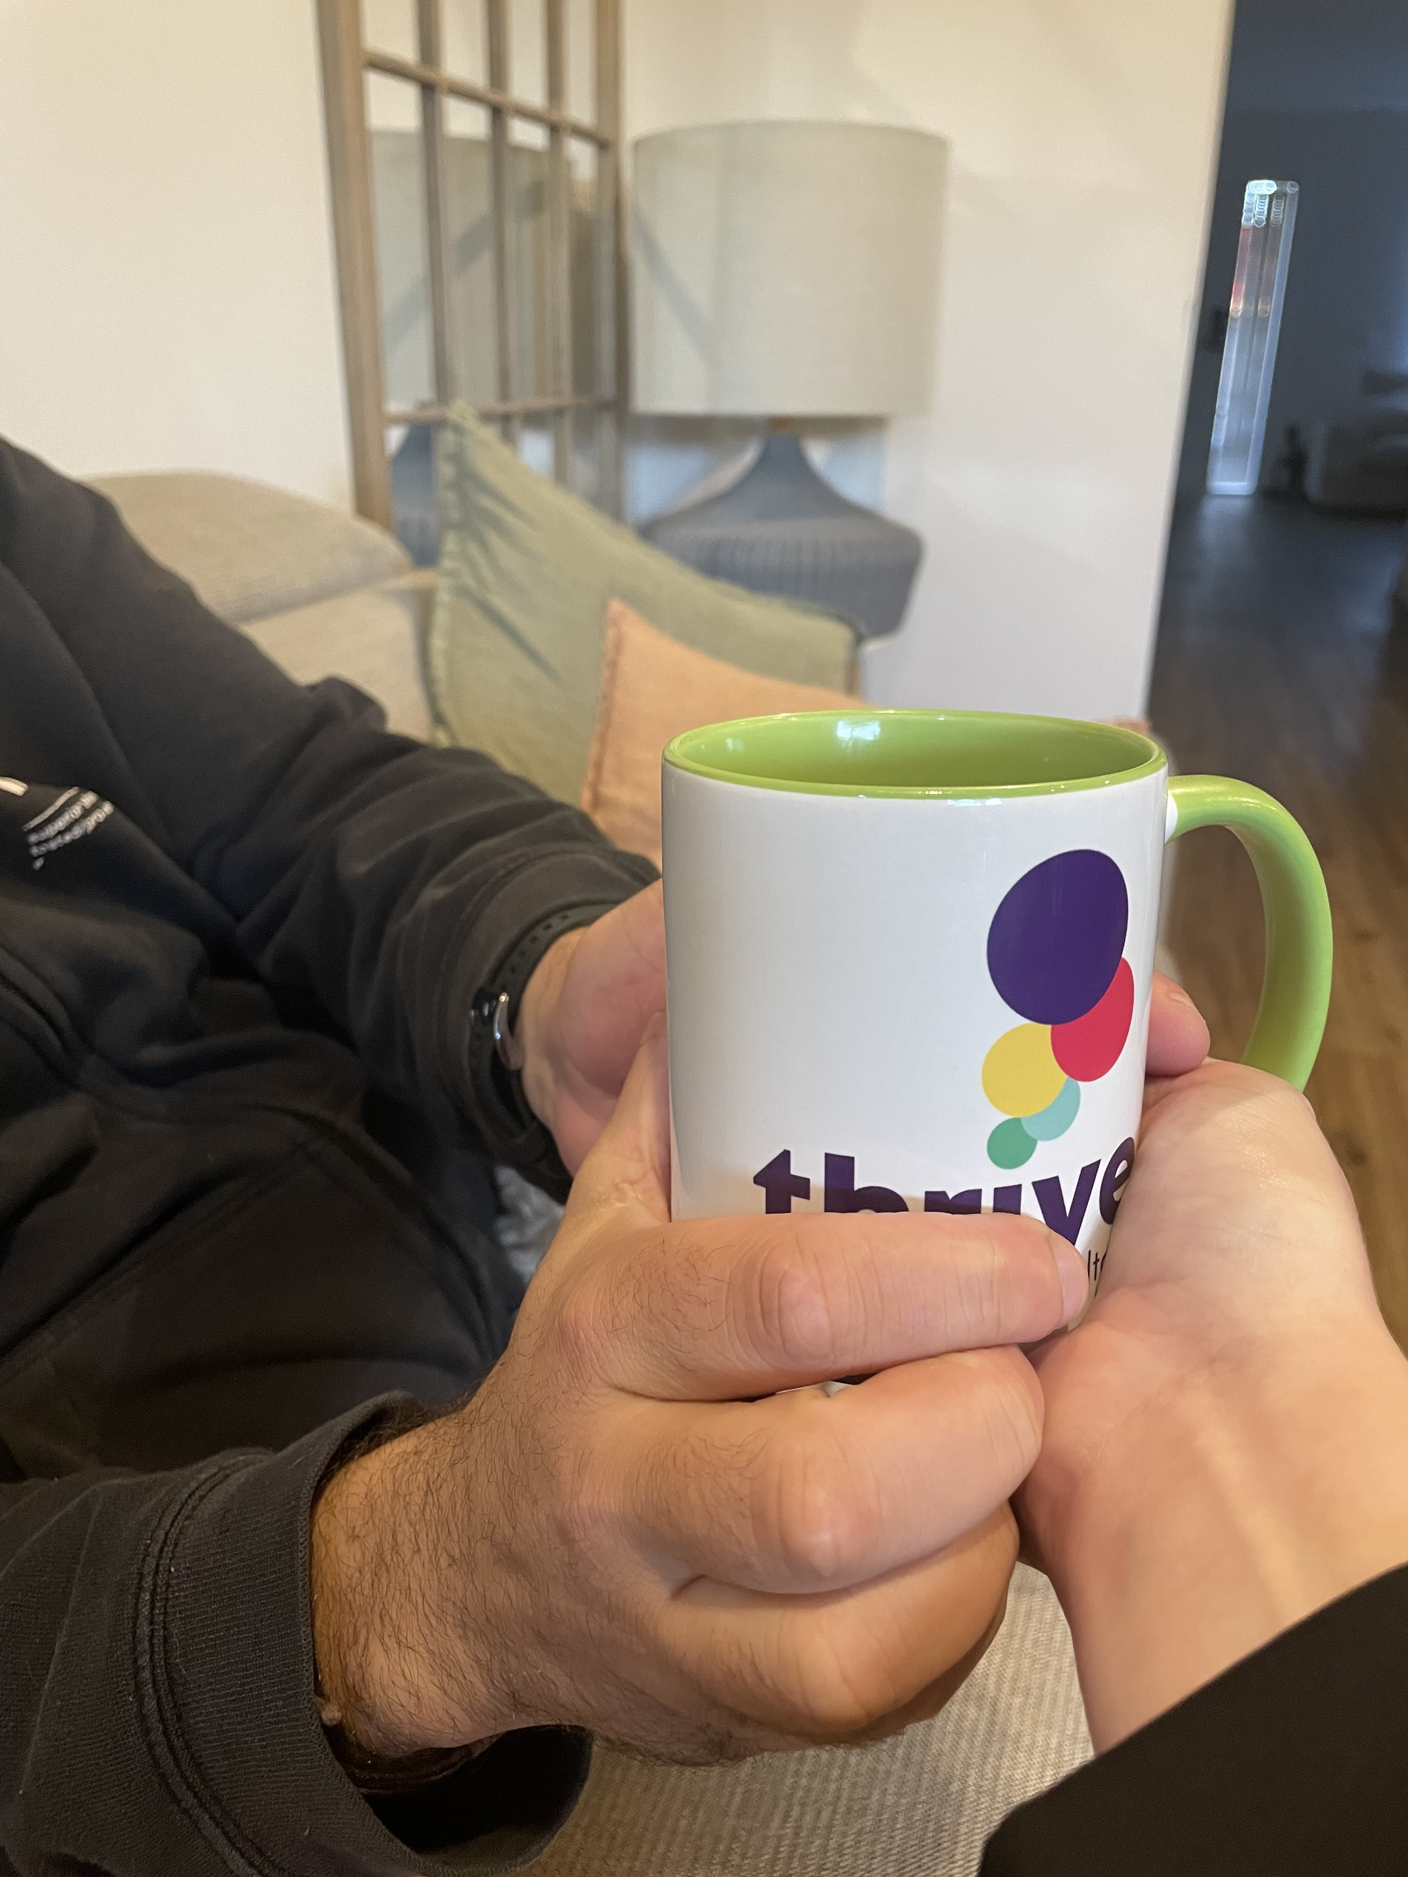
Changing our approach
Verbal:
“Coffee? Or something else”
Visual:
Showing the person the cup
Tactile:
The person feeling the cup
Right
Left
Notes:
So here are some photo examples of how we can enhance our communication, when words alone are not sufficient. Here we use an example of asking someone if they would like a cup of coffee.
Verbal- it is hard to understand what I am asking just from this vision isn’t it? It could be a question…. It might not be.
Visual- here we use a big more of a prompt- showing the cup, smiling and pointing so good use of body here
Tactile-again adding some additional information by using touch. Helping the person to feel the cup and get started with the movement.

Slide 26
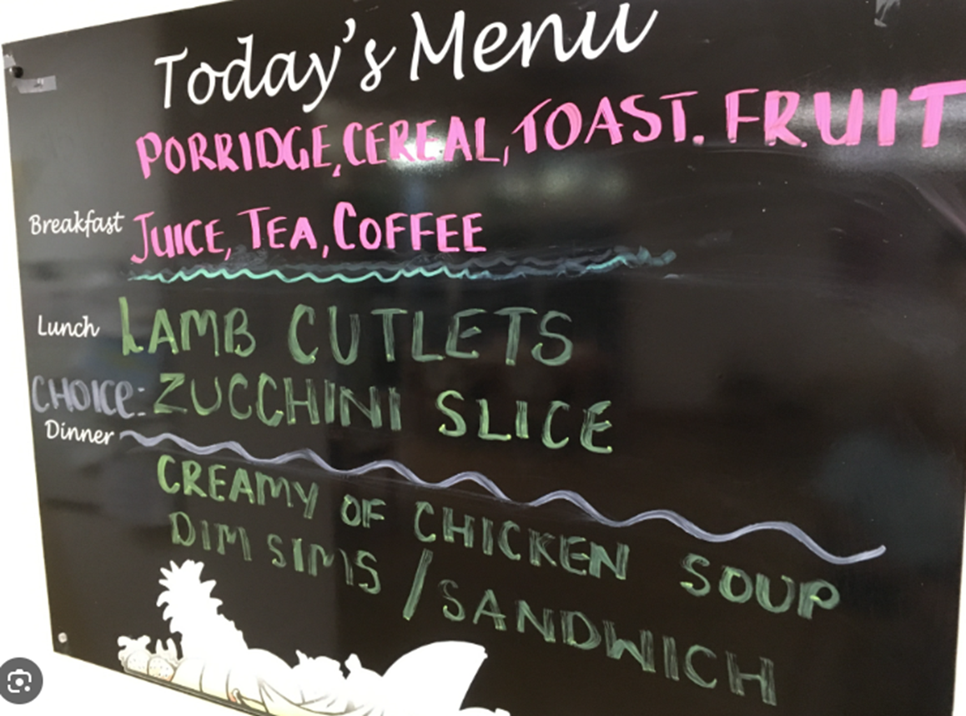
Visual communication- Example
Notes:
Thinking about vision - for people who are ageing, may have additional vision impairment or dementia we also need to think about how we present information.
Another example is a menu board. How words alone, may be hard to read if the person has vision changes, ESL, hard to interpret if they have brain change. So, how can we get our message across? Use a mix of photo’s as well as words.
Now let’s move on and consider some cultural impacts on communication.

Slide 27
Cultural impacts on communication
Our own culture can also impact on the way we communicate.
For example:
Language- we use different words, phrases, gestures
Attitudes- how conflict is approached can differ
Personal space- body contact vs no contact
Eye contact- can be considered rude in some cultures
Occurs due to differences in values, beliefs,
norms and behaviours
Notes:
When we work with others, we need to consider their culture as well. While we have different upbringings, beliefs, behaviours, so do our residents and that is where we can sometimes face challenges.

Slide 28
Cultural sensitivity
“Awareness of commonalities and variations in people’s cultures without labelling them desirable or undesirable.”
How does this look?
Understanding that similarities and variations in people impact their behaviours, perceptions and values.
It is important to help people understand ways in which they appreciate people who are different to them.
Notes:
When we talk about cultural sensitivity we are talking about…..
What does this mean? It means that while our clients/residents may come from different backgrounds, so do we as the staff. We all need to be aware that we are individuals and others may have different beliefs, values etc. It doesn’t make one more important or ‘right’ than the other.
So how do we work with that when perhaps we are feeling ‘targeted’ in the workplace by other- either residnets or staff?

Slide 29
How to overcome cultural barriers
Be aware of your own cultural background and prejudices.
Try to understand and respect the differences of others.
Consider how the message was intended.
Don't make assumptions about others.
Notes:
We absolutely have the right to be safe at work- physically and psychologically. But, it is also important to have some self awareness. We need to understand our own prejudices and how our background may be impacting on how we interpret a situation.
Again, not saying it is ‘right or wrong’ but having the ability to look from the outside in and consider all of the factors that may be at play in the situation.
Sometimes, we may be offended by a comment due to our own values, but we need to consider the intention behind the comment. Consider the body language that went with the words… let’s look at an example of what I mean.

Slide 30
How to work with challenges
Collect and document all of the story.
‘Jack was sexually inappropriate language this morning whilst walking to the shower.’
Vs
‘Jack stated to me ‘you’re looking alright today!’ Writer advised Jack this was inappropriate language to use. He was smiling at me at the time and spoke with a friendly tone. He made no physical contact.’
Notes:
Let’s consider a scenario with Jack. Now, let’s consider that you are looking after Jack and he said something that you found offensive. If this is all that you right in the notes, it doesn’t tell a story does it. What did he say? How did he say it? What was his body language?
Now to me, in this scenario, I would take that as a compliment - I wouldn’t be offended but for someone else, this comment may be deemed not appropriate.
It is important to have all of the details and to share these with the team because, in order to come up with a plan of action, we need to have the full story and the first version of this documentation doesn’t tell us that.

Slide 31
What to do-Challenging communications
Reflect- Are the persons age or cultural factors contributing?
Respond- Redirect, set boundaries, remove yourself
Acknowledge- The situation, how you are feeling, how the other person may be feeling
Document- What actually occurred in detail
Share- The information with others – team and managers
Seek support- To develop a plan and to acknowledge your experience
Take action- To prevent or minimize the occurrence
Notes:
Noone should feel unsafe at work, but we also need to be aware of how are own cultural factors may be playing part. Consider all of the components.

Slide 32
Responding to Jack
Jack is 92 and has some hearing and vision impairment. No cognitive impairment. He is from regional NZ.
‘Jack, you may have meant that comment as a compliment, but I don’t find it appropriate. Please don’t say that again.’
I don’t’ feel unsafe, but I feel uncomfortable due to the words that Jack is using- only my husband should say that to me. Jack has lived in a small town his whole life and has not had much exposure to people from other cultures.
Document in the notes the exact conversation
Handover- ‘Jack stated x to me today. I told him that it made me feel uncomfortable. He said to me ‘can’t you take a compliment, I was being nice?!’
Speak to your team leader- I know Jack meant it as a compliment, I felt uncomfortable but thinking about it, I think I misunderstood his intentions.
I will see how Jack is tomorrow.
Notes:
Noone should feel unsafe at work, but we also need to be aware of how are own cultural factors may be playing part. Consider all of the components.

Slide 33
Takeaway points
Communication includes words, body movements and vocal/voice components
We need to consider contributing factors relating to age that can impact on communication- hearing/vision loss
Brain change can impact on how we receive and interpret information and can affect communication
We need to consider cultural impacts on communication from both the resident and our perspective
When facing challenges with communication, we need to take all of the steps to consider contributing factors and develop a plan of action

Slide 34
Let’s chat

Slide 35
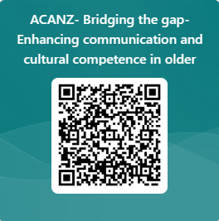
Feedback
www.thriveaged.com.au
http://www.youtube.com/@thriveagedcare

Slide 36
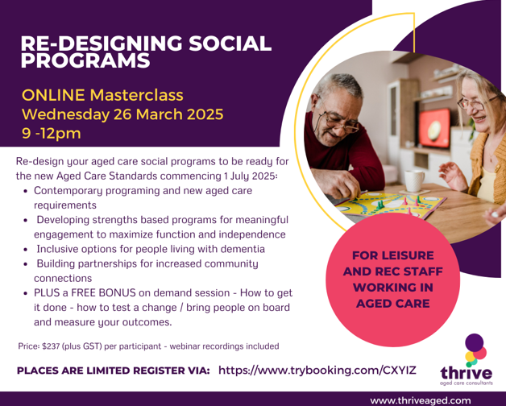
Thrive upcoming training
LEISURE AND RECREATION TEAMS
LEADERS/MANAGERS

Slide 37
Thrive upcoming training
FOOD SERVICES/MANAGERS
ALL STAFF

Slide 38
References
https://www.hdc.org.n z/our-work/aged-care-commissioner/202122-aged-care-complaints/
https://study.com/academy/lesson/cultures-impact-on-interpersonal-communication.html
https://alzheimers.org.nz/explore/facts-and-figures/

Slide 39
Thank you
Kathy Kirby 0401 748 504
kathy@thriveaged.com.au
Kate Lamont 0430 052 492
kate@thriveaged.com.au
www.thriveaged.com.au

